Slide 1
CS 169 Software Engineering
SaaS Architecture
Armando Fox, David Patterson, and Koushik Sen
Spring 2012
Notes:
earliest ever lecture prep! aug 4
follow along download slides

Slide 2
Outline and § ELLS sections
From 100,000 foot view to 500 foot view of SaaS
Client-server architecture, HTTP, URIs, cookies (§2.1-2.2)
HTML & CSS, XML & XPath (§2.2-2.3)
3-tier shared-nothing architecture, horizontal scaling (§2.4)
model-view-controller design pattern (§2.5)
  Models: ActiveRecord & CRUD (§2.6)
  Routes, controllers, and REST (§2.7)
  Template views (§2.8)
Fallacies & pitfalls, perspectives (§2.9-2.12)
Patterns, architecture, & perspective (§2.10)

Slide 3

The Web as a Client-Server System; TCP/IP intro
ELLS §2.1–2.2
Armando Fox
© 2012 Armando Fox & David Patterson
Licensed under Creative Commons Attribution-NonCommercial-ShareAlike 3.0 Unported License
Notes:
earliest ever lecture prep! aug 4
follow along download slides

Slide 4
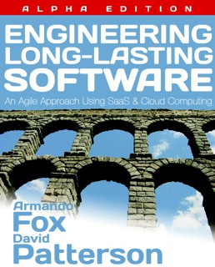
Reminder
This material expands on and gives additional perspectives/demos about the material in ELLS
We assume you will watch the screencasts too
(screencast.saasbook.info)
It does not replace reading that material
http://saasbook.info

Slide 5

Web at 100,000 feet
The web is a client/server architecture
It is fundamentally request/reply oriented
Web browser
Web site
Internet

Slide 6
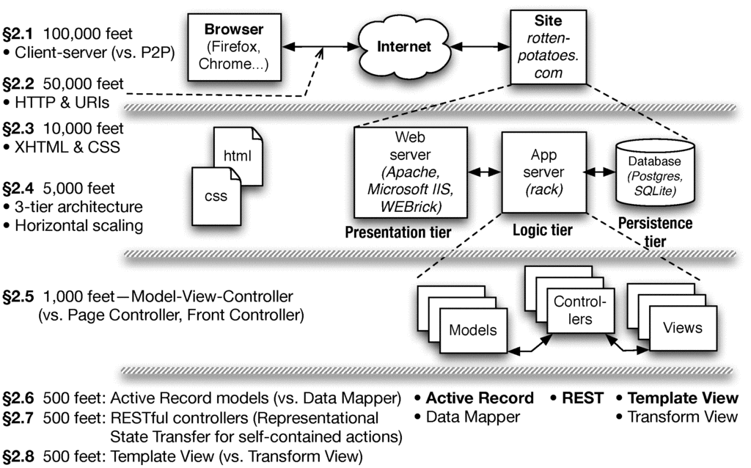

Slide 7


Client-Server vs. Peer-to-Peer
C
C
P
P
S
P
C
P
P
C
P
High-level architecture of the overall system
  Soon we’ll talk about architecture “inside” boxes
Client & server each specialized for their tasks
  Client: ask questions on behalf of users
  Server: wait for & respond to questions, serve many clients
Design Patterns capture common structural solutions to recurring problems
  Client-Server is an architectural pattern

Slide 8
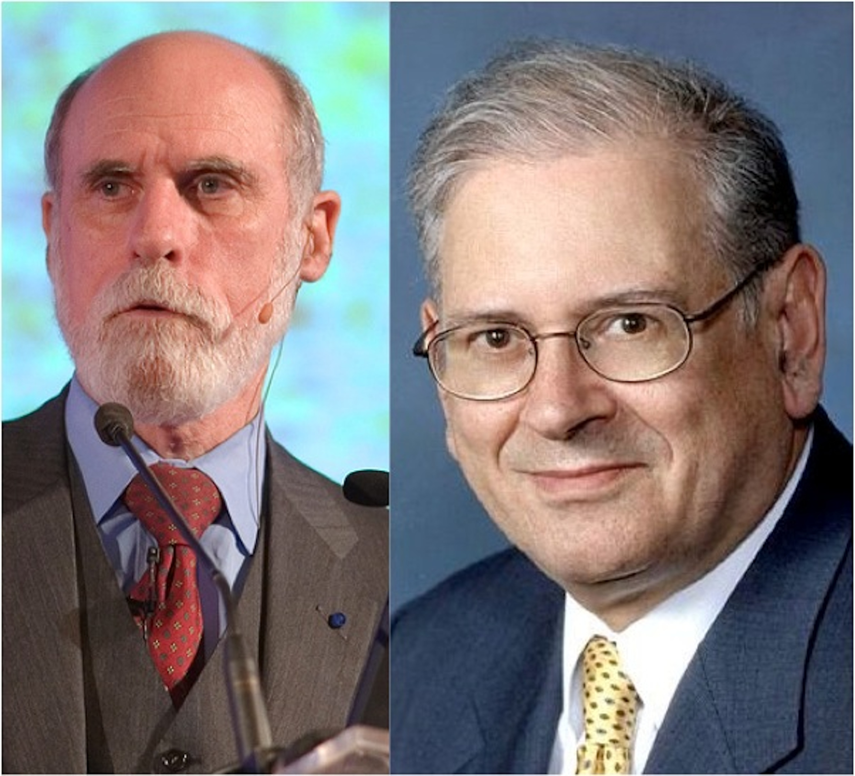
Nuts and bolts:
TCP/IP protocols
IP (Internet Protocol) address identifies a physical network interface with four octets, e.g. 128.32.244.172
  Special address 127.0.0.1 is “this computer”, named localhost, even if not connected to the Internet!
TCP/IP (Transmission Control Protocol/Internet Protocol)
  IP: no-guarantee, best-effort service that delivers packets from one IP address to another
  TCP: make IP reliable by detecting “dropped” packets, data arriving out of order, transmission errors, slow networks, etc., and respond appropriately
  TCP ports allow multiple TCP apps on same computer
Vint Cerf & Bob Kahn: 2004 Turing Award for
Internet architecture & protocols, incl. TCP/IP
GET /bears/
GET /bears/
HTTP/0.9 200 OK
HTTP/0.9 200 OK

Slide 9
Web at 100,000 feet
The web is a client/server architecture
It is fundamentally request/reply oriented
Domain Name System (DNS) is another kind of server that maps names to IP addresses
Web browser
Web site
DNS server

Slide 10
Now that we’re talking, what do we say?
Hypertext Transfer Protocol
an ASCII-based request/reply protocol for transferring information on the Web
HTTP request includes:
  request method (GET, POST, etc.)
  Uniform Resource Identifier (URI)
  HTTP protocol version understood by the client
  headers—extra info regarding transfer request
HTTP response from server
  Protocol version & Status code =>
  Response headers
  Response body
HTTP status codes:
2xx — all is well
3xx — resource moved
4xx — access problem
5xx — server error
Notes:
DEMO: nc –l 8000, then GET /la/di/da
DEMO: telnet www.cs.berkeley.edu 80
GET /bears/ HTTP/1.0

Slide 11
Assuming “>” means “relies on”, which statement is NOT correct:
☐
DNS > IP
☐
HTTP > TCP > IP
☐
TCP > DNS
☐
All the above are correct
Notes:
VertLeftWhiteCheck1

Slide 12
Cookies
Observation: HTTP is stateless
Early Web 1.0 problem: how to guide a user “through” a flow of pages?
  use IP address to identify returning user?
  ✖ public computers, users sharing single IP
  embed per-user junk into URI query string?
  ✖ breaks caching
Quickly superseded by cookies
  Watch: screencast.saasbook.info
Notes:
Demo: see cookie arriving from Google.com
curl -D - http://www.google.com -o /dev/null

Slide 13
Uses of cookies
Most sites quickly realized that the per-user state could be used for lots of things:
  customization (“My Yahoo”)
  click tracking/flow tracking
  authentication (logged in or not)
  Which of these could be implemented on the client side? Which ones shouldn’t be and why?
A golden rule: don’t trust the client—cookies must be tamper-evident

Slide 14
A ____ can create and modify cookies;
the ____ is responsible for including the correct cookie with each request
☐
Browser; SaaS app
☐
SaaS app; browser
☐
HTTP request; browser
☐
SaaS app; HTTP response
Notes:
VertLeftWhiteCheck1

Slide 15
HTML+CSS
ELLS §2.3
Armando Fox
© 2012 Armando Fox & David Patterson
Licensed under Creative Commons Attribution-NonCommercial-ShareAlike 3.0 Unported License
Notes:
earliest ever lecture prep! aug 4
follow along download slides

Slide 17
Introduction
This article is a review of the book
Dietary Preferences of Penguins,
by Alice Jones and Bill Smith. Jones
and Smith's controversial work makes
three hard-to-swallow claims about
penguins:
First, that penguins actually prefer
tropical foods such as bananas and
pineapple to their traditional diet
of fish
Second, that tropical foods give
penguins an odor that makes them
unattractive to their traditional
predators
CS 142 Lecture Notes: HTML
Slide <number>

Slide 18
<h1>Introduction</h1>
<p>
This article is a review of the book
<i>Dietary Preferences of Penguins</i>,
by Alice Jones and Bill Smith. Jones and Smith's
controversial work makes three hard-to-swallow claims
about penguins:
</p>
<ul>
<li>
First, that penguins actually prefer tropical foods
such as bananas and pineapple to their traditional diet
of fish
</li>
<li>
Second, that tropical foods give penguins an odor that
makes them unattractive to their traditional predators
</li>
</ul>
...
CS 142 Lecture Notes: HTML
Slide <number>
Notes:
markup indicates structure of document (used to also indicate visual style, but that's chnaged)
markup and text are both plain ASCII
elements are demarcated by open and close tags, and can be nested.

Slide 19
Introduction
This article is a review of the book Dietary Preferences of Penguins, by Alice Jones and Bill Smith. Jones and Smith's controversial work makes two hard-to-swallow claims about penguins:
  First, that penguins actually prefer tropical foods such as bananas and pineapple to their traditional diet of fish
  Second, that tropical foods give penguins an odor that makes them unattractive to their traditional predators
...
<h1>Introduction</h1>
<p>
This article is a review of the book
<i>Dietary Preferences of Penguins</i>,
by Alice Jones and Bill Smith. Jones
and Smith's controversial work makes
three hard-to-swallow claims about
penguins:
<ul>
<li>
First, ...
CS 142 Lecture Notes: HTML
Slide <number>

Slide 20
HTML ~1.0
Descendant of IBM’s Generalized Markup Language (1960’s) via SGML (Standard Generalized Markup Language, 1986)
Document = Hierarchical collection of elements
  inline (headings, tables, lists...)
  embedded (images, JavaScript code...)
  forms—allow user to submit simple input (text, radio/check buttons, dropdown menus...)
Each element can have attributes (many optional) and some elements also have content
  of particular interest: id and class attributes, for styling

Slide 21
Cascading Style Sheets
Idea: visual appearance of page described in a separate document (stylesheet)
  accessibility
  branding/targeting
  separate designers’ & developers’ concerns
Current best practice: HTML markup should contain no visual styling information

Slide 22
How does it work?
<link rel="stylesheet" href="http://..."/> (inside <head> element) says what stylesheet goes with this HTML page
HTML id & class attributes important in CSS
  id must be unique within this page
  same class can be attached to many elements
  <div id="right" class="content">
  <p>
  I'm Armando. I teach CS169 and do
  research in the AMP Lab and Par Lab.
  </p>
  </div>
Notes:
Open Web Developer toolbar
Show two audience1st.com pages side by side
Show "Info > display elemet information"

Slide 23
Selectors identify specific tag(s)
<div class="pageFrame" id="pageHead">
<h1>
Welcome,
<span id="custName">Armando</span>
<img src="welcome.jpg" id="welcome"/>
</h1>
</div>
tag name: h1
class name: .pageFrame
element ID: #pageHead
tag name & class: div.pageFrame
tag name & id: img#welcome (usually redundant)
descendant relationship: div .custName
Attributes inherit browser defaults unless overridden
both of these match the outer div above. Don’t do this!
Notes:
visit Csszengarden.co
also turn off all styles

Slide 24
Which CSS selector will select only the word “bar” for styling:
<p class="a">foo,
<span class="a">bar<span></p>
☐
span.a
☐
p .a
☐
.a span
☐
All of these
Notes:
VertLeftWhiteCheck1

Slide 25
3-tier shared-nothing architecture & scaling
ELLS §2.4
Armando Fox
© 2012 Armando Fox & David Patterson
Licensed under Creative Commons Attribution-NonCommercial-ShareAlike 3.0 Unported License
Notes:
earliest ever lecture prep! aug 4
follow along download slides

Slide 27
Dynamic content generation
In the Elder Days, most web pages were (collections of) plain old files
But most interesting Web 1.0/e-commerce sites actually run a program to generate the “page”
Originally: templates with embedded code “snippets”
Eventually, code became “tail that wagged the dog” and moved out of the Web server

Slide 28
Sites that are really programs (SaaS)
How do you:
  “map” URI to correct program & function?
  pass arguments?
  invoke program on server?
  handle persistent storage?
  handle cookies?
  handle errors?
  package output back to user?
Frameworks support these common tasks
persistence
Filesystem
or database
logic (app)
your app
Common Gateway Interface (CGI)
presentation (Web server)
client (browser)
Notes:
HTTP stateless: IP addr? cookies? sessions in DB? other?
(why would you consider a specialized store?)

Slide 29

Developer environment vs. medium-scale deployment
file.sqlite3
MySQL
PostgreSQL
Database
cache
SQLite adapter
MySQL adapter
MySQL adapter
MySQL adapter
“Dynos” running
apps
Rails library
Rails library
Rails library
Rails library
rack
rack
rack
rack
Webrick
thin
thin
thin
HTTP servers & static asset caches
Page cache
Apache w/mod_rails + caching mode
Large-scale curated
deployment, e.g. Heroku
Developer
Medium-scale deployment
Notes:
Why small machine for DB?
How many processes & how many machines in each example?

Slide 30
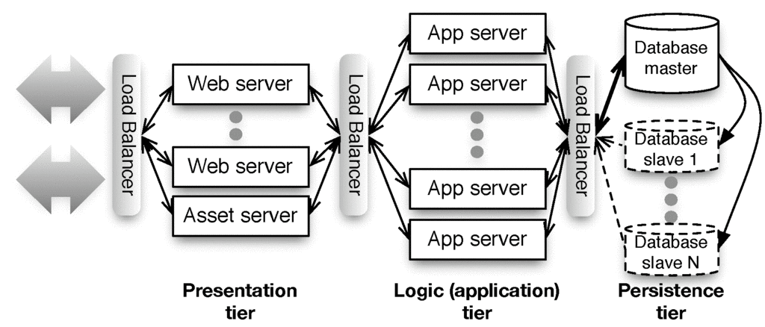
“Shared nothing”

Slide 31
Sharding vs. Replication
Partition data across independent “shards”?
  + Scales great
  Bad when operations touch >1 table
  Example use: user profile
Replicate all data everywhere?
  + Multi-table queries fast
  Hard to scale: writes must propagate to all copies => temporary inconsistency in data values
  Example: Facebook wall posts/“likes”
App server
users A-J
App server
users K-R
App server
users S-Z
App server
All users
App server
All users
App server
All users
Notes:
MESSAGE: can't magically scale persistence tier. Subject of active R&D, including NoSQL and other stuff we will learn about in 2nd half of class.

Slide 32
Summary: Web 1.0 SaaS
Browser requests web resource (URI) using HTTP
  HTTP is a simple request-reply protocol that relies on TCP/IP
  In SaaS, most URI’s cause a program to be run, rather than a static file to be fetched
HTML is used to encode content, CSS to style it visually
Cookies allow server to track client
  Browser automatically passes cookie to server on each request
  Server may change cookie on each response
  Typical usage: cookie includes a handle to server-side information
  That’s why some sites don’t work if cookies are completely disabled
Frameworks make all these abstractions convenient for programmers to use, without sweating the details
...and help map SaaS to 3-tier, shared-nothing architecture

Slide 33
Match the terms:
(a) presentation tier, (b) logic tier,
(c) persistence tier
☐
(a) Apache web server (b) Rack+Rails
(c) Relational database
☐
(a) Firefox (b) Apache web server
(c) PostgreSQL
☐
(a) Microsoft Internet Information Server
(b) Rack+Rails (c) Apache web server
☐
(a) Firefox (b) Microsoft Internet Information Server (c) MySQL
Notes:
VertLeftWhiteCheck1

Slide 34
Model-View-Controller
ELLS §2.5
Armando Fox
© 2012 Armando Fox & David Patterson
Licensed under Creative Commons Attribution-NonCommercial-ShareAlike 3.0 Unported License
Notes:
earliest ever lecture prep! aug 4
follow along download slides

Slide 36
The MVC Design Pattern
Goal: separate organization of data (model) from UI & presentation (view) by introducing controller
  mediates user actions requesting access to data
  presents data for rendering by the view
Web apps may seem “obviously” MVC by design, but other alternatives are possible...
• Read data
• Update data
• User actions
• Directives for rendering data
Controller
View
Model
• Data provided to views through controller

Slide 37

Each entity has a model, controller, & set of views
Movies
Controller
Movie
Moviegoers
Controller
Reviews
Controller
Moviegoer
Review

Slide 38
Alternatives to MVC
Page Controller
(Ruby Sinatra)
Front Controller
(J2EE servlet)
Template View (PHP)
models
models
models
page A
A
app
views
page B
B
views
page C
C
Rails supports SaaS apps structured as MVC, but other architectures may be better fit for some apps.

Slide 39
Which statement is NOT true about the Model-View-Controller (MVC) architectural pattern:
☐
In SaaS apps on the Web, controller actions and view contents are transmitted using HTTP.
☐
All MVC apps have both a “client” part (e.g. Web browser) and a “cloud” part (e.g. Rails app on cloud).
☐
Model-View-Controller is just one of several possible ways to structure a SaaS app.
☐
Peer-to-peer apps can be structured as Model-View-Controller.
Notes:
VertLeftWhiteCheck1

Slide 40
Models, Databases, and Active Record
ELLS §2.6
Armando Fox
© 2012 Armando Fox & David Patterson
Licensed under Creative Commons Attribution-NonCommercial-ShareAlike 3.0 Unported License
Notes:
earliest ever lecture prep! aug 4
follow along download slides

Slide 42
In-Memory vs. In-Storage objects
#<Movie:0x1295580>
m.name, m.rating, ...
marshal/serialize
?
#<Movie:0x32ffe416>
m.name, m.rating, ...
unmarshal/deserialize
How to represent persisted object in storage
  Example: Movie and Reviews
Basic operations on object: CRUD (Create, Read, Update, Delete)
ActiveRecord: every model knows how to CRUD itself, using common mechanisms

Slide 43
Rails Models Store Data in Relational Databases (RDBMS)
Each type of model gets its own database table
  All rows in table have identical structure
  1 row in table == one model instance
  Each column stores value of an attribute of the model
  Each row has unique value for primary key (by convention, in Rails this is an integer and is called id)
Schema: Collection of all tables and their structure
id | rating | title | release_date
2 | G | Gone With the Wind | 1939-12-15
11 | PG | Casablanca | 1942-11-26
... | ... | ... | ...
35 | PG | Star Wars | 1977-05-25

Slide 44
Alternative: DataMapper
Data Mapper associates separate mapper with each model
  Idea: keep mapping independent of particular data store used => works with more types of databases
  Used by Google AppEngine
  Con: can’t exploit
  RDBMS features to
  simplify complex
  queries & relationships
We’ll revisit when
talking about
associations

Slide 45
Which statement is not true about the Model in Model-View-Controller:
☐
The CRUD actions only apply to models backed by a database that supports ActiveRecord.
☐
Part of the Model’s job is to convert between in-memory and stored representations of objects.
☐
Although Model data is displayed by the View, a Models’ direct interaction is with Controllers.
☐
Although DataMapper doesn’t use relational databases, it’s a valid way to implement a Model.
Notes:
VertLeftWhiteCheck1

Slide 46
Controllers, Routes, and RESTfulness
ELLS §2.7
Armando Fox
© 2012 Armando Fox & David Patterson
Licensed under Creative Commons Attribution-NonCommercial-ShareAlike 3.0 Unported License
Notes:
earliest ever lecture prep! aug 4
follow along download slides

Slide 48
Routes
In MVC, each interaction the user can do is handled by a controller action
  Ruby method that handles that interaction
A route maps <HTTP method, URI> to controller action
Route | Action
GET /movies/3 | Show info about movie whose ID=3
POST /movies | Create new movie from attached form data
PUT /movies/5 | Update movie ID 5 from attached form data
DELETE /movies/5 | Delete movie whose ID=5

Slide 49
Brief Intro to Rails’ Routing Subsystem
dispatch <method,URI> to correct controller action
provides helper methods that generate a <method,URI> pair given a controller action
parses query parameters from both URI and form submission into a convenient hash
Built-in shortcuts to generate all CRUD routes (though most apps will also have other routes)
rake routes
I GET /movies {:action=>"index", :controller=>"movies"}
C POST /movies {:action=>"create", :controller=>"movies"}
GET /movies/new {:action=>"new", :controller=>"movies"}
GET /movies/:id/edit {:action=>"edit", :controller=>"movies"}
R GET /movies/:id {:action=>"show", :controller=>"movies"}
U PUT /movies/:id {:action=>"update", :controller=>"movies"}
D DELETE /movies/:id {:action=>"destroy", :controller=>"movies"}
Notes:
Most apps will have routes

Slide 50
GET /movies/3/edit HTTP/1.0
Matches route:
GET /movies/:id/edit {:action=>"edit", :controller=>"movies"}
Parse wildcard parameters: params[:id] = "3"
Dispatch to edit method in movies_controller.rb
To include a URI in generated view that will submit the form to the update controller action with params[:id]==3, call helper:
update_movie_path(3) # => PUT /movies/3
rake routes
I GET /movies {:action=>"index", :controller=>"movies"}
C POST /movies {:action=>"create", :controller=>"movies"}
GET /movies/new {:action=>"new", :controller=>"movies"}
GET /movies/:id/edit {:action=>"edit", :controller=>"movies"}
R GET /movies/:id {:action=>"show", :controller=>"movies"}
U PUT /movies/:id {:action=>"update", :controller=>"movies"}
D DELETE /movies/:id {:action=>"destroy", :controller=>"movies"}

Slide 51
REST (Representational State Transfer)
Idea: Self-contained requests specify what resource to operate on and what to do to it
  Roy Fielding’s PhD thesis, 2000
  Wikipedia: “a post hoc description of the features that made the Web successful”
A service (in the SOA sense) whose operations are like this is a RESTful service
Ideally, RESTful URIs name the operations
Let’s see an anti-example:
http://pastebin.com/edF2NzCF

Slide 52
Which statement is NOT true regarding Rails RESTful routes and the resources to which they refer:
☐
A resource may be existing content or a request to modify something.
☐
Every route must eventually trigger a controller action.
☐
One common set of RESTful actions is the CRUD actions on models.
☐
The route always contains one or more parameters, such as :id, to identify the resource
Notes:
VertLeftWhiteCheck1

Slide 53
Template Views and Haml
ELLS §2.8
Armando Fox
© 2012 Armando Fox & David Patterson
Licensed under Creative Commons Attribution-NonCommercial-ShareAlike 3.0 Unported License
Notes:
earliest ever lecture prep! aug 4
follow along download slides

Slide 55
Template View pattern
View consists of markup with selected interpolation to happen at runtime
  Usually, values of variables or result of evaluating short bits of code
In Elder Days, this was the app (e.g. PHP)
Alternative: Transform View
Haml
Closure
XML
Closure
Renderer (Action-View)
RJS
(remote Java-Script)
Renderer (Action-View)
HTML
Movie
JSON
erb
Movie
Movie

Slide 56
Haml is HTML on a diet
%h1.pagename All Movies
%table#movies
%thead
%tr
%th Movie Title
%th Release Date
%th More Info
%tbody
- @movies.each do |movie|
%tr
%td= movie.title
%td= movie.release_date
%td= link_to "More on #{movie.title}", |
movie_path(movie) |
= link_to 'Add new movie', new_movie_path
Notes:
no open/close tags: use indentation
tag entirely on single line, or use indentation to indicate nesting
how to specify ID & class
code that is exectued but NOT substituted
note lack of 'end' for 'do': implied by indentation
code that is executed and substituted
multi-line – deliberately awkward

Slide 57
Don’t put code in your views
Syntactically, you can put any code in view
But MVC advocates thin views & controllers
  Haml makes deliberately awkward to put in lots of code
Helpers (methods that “prettify” objects for including in views) have their own place in Rails app
Alternative to Haml: html.erb (Embedded Ruby) templates, look more like PHP

Slide 58
What happens if you embed code in your Rails views that directly accesses the model?
☐
It will work, but it’s bad form and violates the MVC guidelines
☐
It will work when developing against a “toy” database, but not in production
☐
It won’t work, because Views can’t communicate directly with Models
☐
Behavior varies depending on the app
Notes:
VertLeftWhiteCheck1

Slide 59
Summary & Reflections:
SaaS Architecture
Armando Fox
© 2012 Armando Fox & David Patterson
Licensed under Creative Commons Attribution-NonCommercial-ShareAlike 3.0 Unported License
Notes:
earliest ever lecture prep! aug 4
follow along download slides

Slide 60
The big picture (technologies)
• URI’s, HTTP, TCP/IP stack
• REST & RESTful routes
Controller
View
Model
• Databases & migrations
• CRUD
• HTML & CSS
• XML & XPath
Notes:
NOTE: Rails doesn't appear anywhere on this slide!!

Slide 61
c. 2008: “Rails doesn’t scale”
Scalability is an architectural concern—not confined to language or framework
The stateless tiers of 3-tier arch do scale
  With cloud computing, just worry about constants
Traditional relational databases do not scale
Various solutions combining relational and non-relational storage (“NoSQL”) scale much better
  DataMapper works well with some of them
Intelligent use of caching (later in course) can greatly improve the constant factors

Slide 62
Frameworks, Apps, Design patterns
Many design patterns so far, more to come
In 1995, it was the wild west: biggest Web sites were minicomputers, not 3-tier/cloud
Best practices (patterns) “extracted” from experience and captured in frameworks
But API’s transcended it: 1969 protocols + 1960s markup language + 1990 browser + 1992 Web server works in 2011

Slide 63
Architecture is about Alternatives
Pattern we’re using | Alternatives
Client-Server | Peer-to-Peer
Shared-nothing (cloud computing) | Symmetric multiprocessor, shared global address space
Model-View-Controller | Page controller, Front controller, Template view
Active Record | Data Mapper
RESTful URIs (all state affecting request is explicit) | Same URI does different things depending on internal state
As you work on other SaaS apps beyond this course, you should find yourself considering different architectural choices and questioning the choices being made.

Slide 64
Summary: Architecture & Rails
Model-view-controller is a well known architectural pattern for structuring apps
Rails codifies SaaS app structure as MVC
Views are Haml w/embedded Ruby code, transformed to HTML when sent to browser
Models are stored in tables of a relational database, accessed using ActiveRecord
Controllers tie views and models together via routes and code in controller methods

Slide 65
Other factors being equal, which statement is NOT true regarding SaaS scalability?
☐
Shared-nothing clusters scale better than systems built from mainframes
☐
Relational databases scale better than “NoSQL” databases
☐
The programming language used (Ruby, Java, etc.) isn’t a main factor in scalability
☐
Scalability can be impeded by any part of the app that becomes a bottleneck
Notes:
VertLeftWhiteCheck1

